Slide 1

Polynomial Calculator
Adrian-Ioan Tuns

Slide 2
Idea
The idea for the Polynomial Calculator Project appeared as a need for a cross-platform, easy to use calculator for polynomials computing.
The calculator works on polynomials of integer coefficients with one variable.

Slide 3
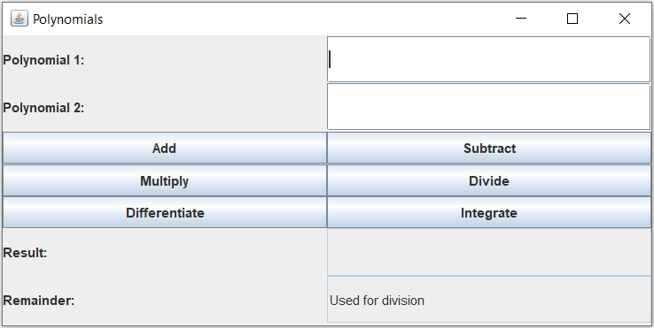
Calculator GUI

Slide 4

Mvc Design Pattern

Slide 5
Implementation of MVC
Model: polynomial.
View: a simple Graphical User Interface.
Controller: a class which reads and processes the input from the text fields in the "View" and sends the output back to the "View".
The project contains 4 packages: one for each of the MVC units and one for the Main function, which combines the other three packages.

Slide 6
Model
The "model" package has a Monomial class, which represents the core of the entire model, that it’s divided into IntegerMonomials and RealMonomials.
The previous mentioned are part of the Polynomial class.
The PolynomialUtilites represents the last class of the package.

Slide 7
View
The "view" package consists of the class UserInterface, which is responsible for creating the Graphical User Interface.
Makes use of the Swing toolkit from Java.

Slide 8
Controller
The “controller" package consists of a single class that has the same name, which contains an UserInterface object, that reads the input data and process it, parsing the String input into Polynomial type objects.
The parsing is handled by Java Regex package, using the Pattern and Matcher classes.

Slide 9
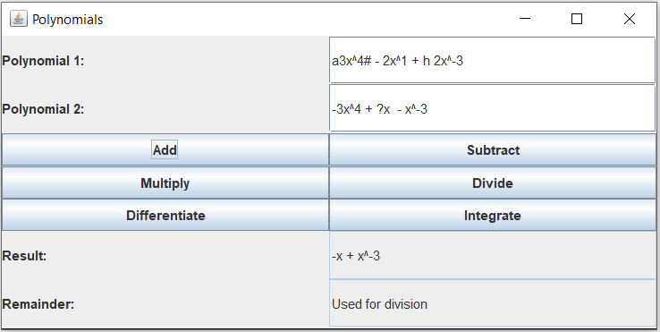
Feature
If some random key was pressed while typing the input, instead of giving an error, the calculator will search for the valid characters and ignore the rest.

Slide 10
Further development
Adding polynomials with more than one variable.
Finding the roots of an equation Polynomial = 0.
Improving the Graphical User Interface.
Memory buttons, to save polynomial in memory and recall when needed.

Slide 11

Questions?

